Slide 1
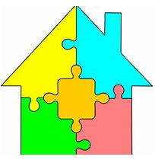
Why is Wp3`s work important to ZEN?
Wp3: Responsive and energy efficient buildings
Judith Thomsen, SINTEF Byggforsk
Notes:
Goal:
cost effective, responsive,
resource and energy efficient buildings by developing low carbon technologies and construction systems based on lifecycle design strategies.

Slide 2
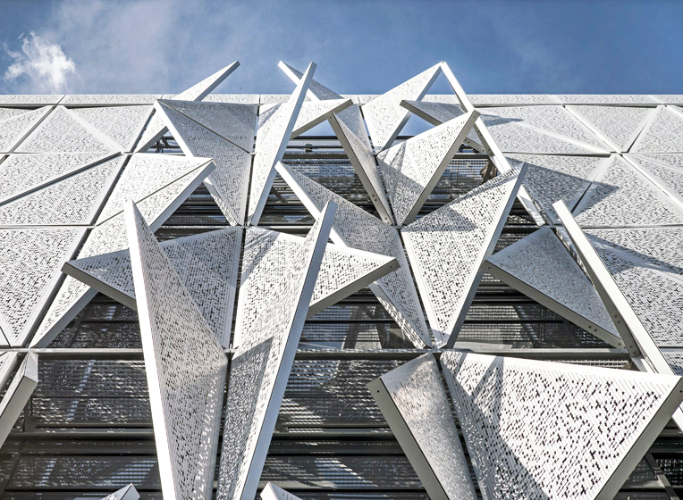
Focus on building solutions
Task 3.1
Resource efficient materials and construction systems
Task 3.2
Low emission building services
Task 3.3
Architecture and building design procedures
ZEB Living Lab
Photo: Ole Tolstad/NTNU

Slide 3
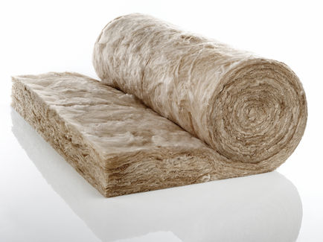
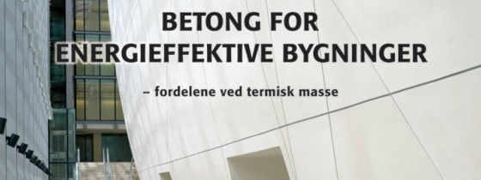
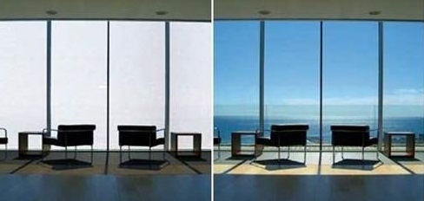
What do we work on?
Test and evaluate materials` properties
Parametric studies in order to optimize design, costs and environmental impact
Develop definitions for responsiveness
Review existing responsive facade technologies
Simulate and measure thermal properties of materials in real life and model

Slide 4
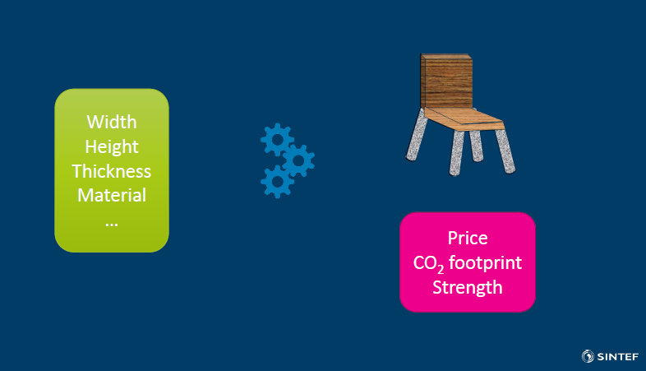
Example:
Parametric design method in order to optimize design, costs and environmental impact
Notes:
Design exploration method in order to optimze. It is based on an input of different parameters of an object or a construction in order to explore the consequences and the dependencies. If we reduce the thickness of a certain material of the chair what are the consequences for price and strength? Moreover what does the choice material or changing type of material mean for the CO2 footprint.

Slide 5
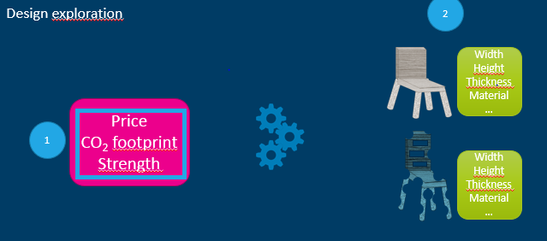
More questions about parametric LCA method? Contact: Nathalie Labonnote / Christofer Skaar
Notes:
Exploring the different parameters and their interdendencies may lead to even new design outcomes, in the example of the chair an (hypothetic) optimization of width, height, thickness in relation to the material and the associated properties of the material. The chair just as en exemplification. We plan to apply this method to a load bearing wood structure provide by one of our partners. As well as to other components or parts of installations or parts of construction.

Slide 6
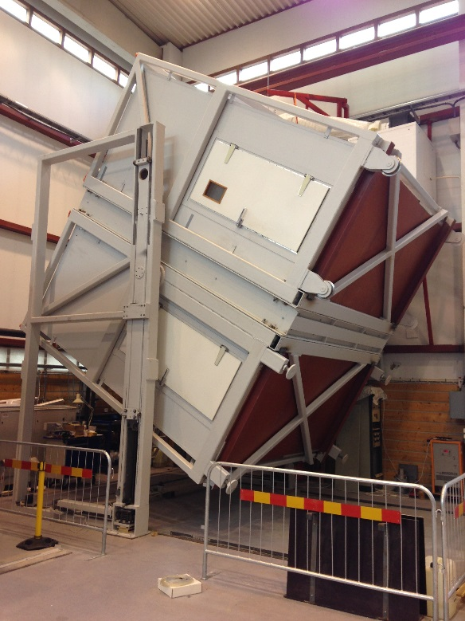
Example:
Laboratory experiment: insulation material
Measurements of wood fiber insulations` thermal conductivity properties compared to mineral wools`
In different temperatures
In different angels (simulating use in roof, floor, wall)
Different moisture conten
Why important to ZEN?
if properties are comparable, local production in Norway and low environmental impact of wood fiber production would suggest this to be a good choice for ZEN
Notes:
-if properties are comparable to mineral wool, additional qualities such as local production in Norway and lower environmental impact of wood fiber production would suggest this to be a good choice for buildings in ZEN areas.

Slide 7

Building design`s relevance to ZEN?
Notes:
Building design as piece of a jig-saw puzzle.
The specific design has to fit and to correspond with a greater system.
Solutions developed for buildings will also be relevant for neighbourhoods either through muliplication or connection..

Slide 8

Building design`s relevance to ZEN?
Notes:
Building as piece of a jig-saw puzzle.
The specific design has to fit and to correspond with a greater system.
Solutions developed for buildings will also be relevant for neighbourhoods either through muliplication or connection..

Slide 9
Building design`s relevance to ZEN?
One good solution
Notes:
Building as piece of a jig-saw puzzle.
The specific design has to fit and to correspond with a greater system.
Solutions developed for buildings will also be relevant for neighbourhoods either through muliplication or connection..

Slide 10
Building design`s relevance to ZEN?
Multipication of good solutions
Notes:
Building as piece of a jig-saw puzzle.
The specific design has to fit and to correspond with a greater system.
Solutions developed for buildings will also be relevant for neighbourhoods either through muliplication or connection..

Slide 11
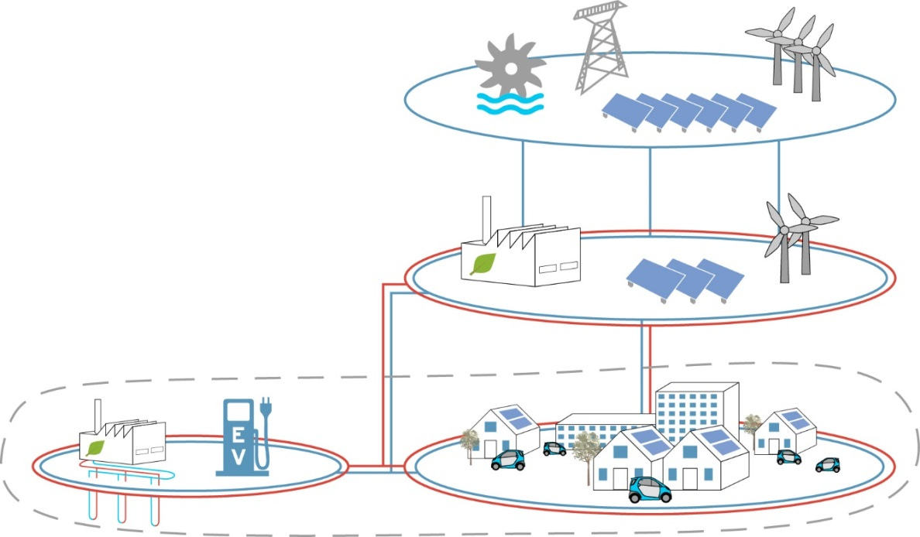
Building design`s relevance to ZEN?
Notes:
Building as piece of a jig-saw puzzle.
The specific design has to fit and to correspond with a greater system.
Solutions developed for buildings will also be relevant for neighbourhoods either through muliplication or connection..

Slide 12
Takk for oppmerksomheten

Slide 13
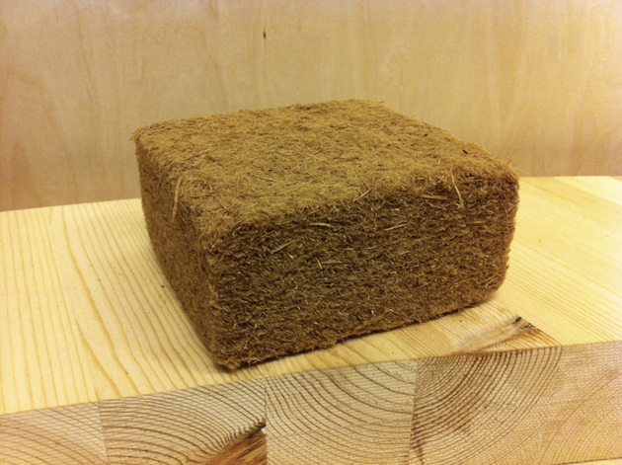
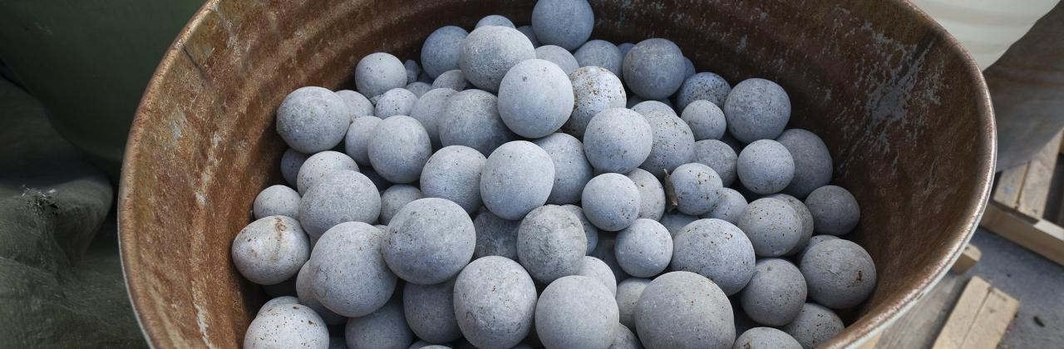
Three different types of responsive methods:
Non-adaptable measures
may seem as a paradox within the scope of responsive behaviour but it is part of climate-responsive design because it concerns energy-saving measures that focus on comfort provision while managing ambient energy flows (e.g. insulation or thermal mass).
(IOPscience, 2014)

Slide 14
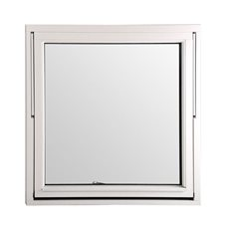
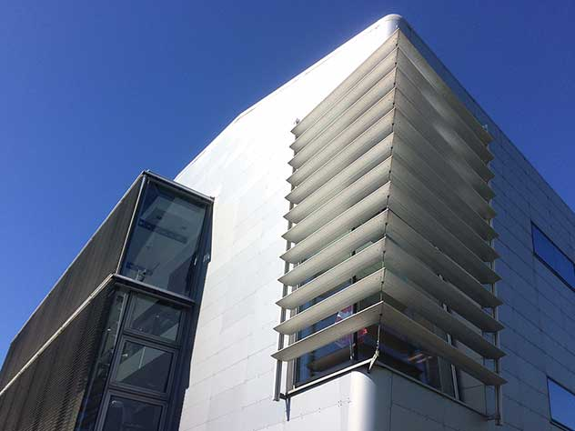
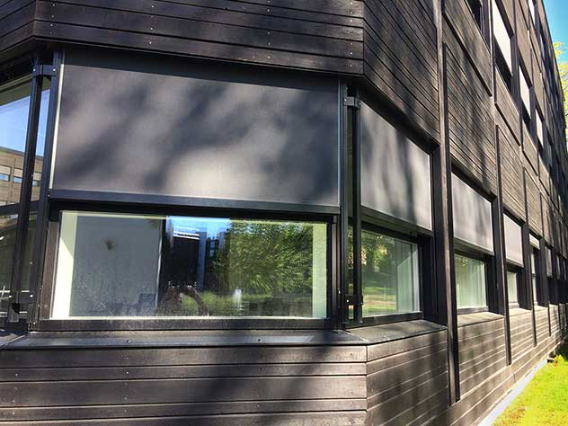
Three different types of responsive methods:
Adaptable measures
change state by intervention in the form of active control. In the simplest form the state is changed through user-intervention (e.g. opening windows, lowering blinds). This manoeuvre can also be automated using for example time switches, thermostats or other sensors. The use of intelligent systems that include learning curves or anticipated behaviour may increase performance of adaptable measures.
(IOPscience, 2014)

Slide 15
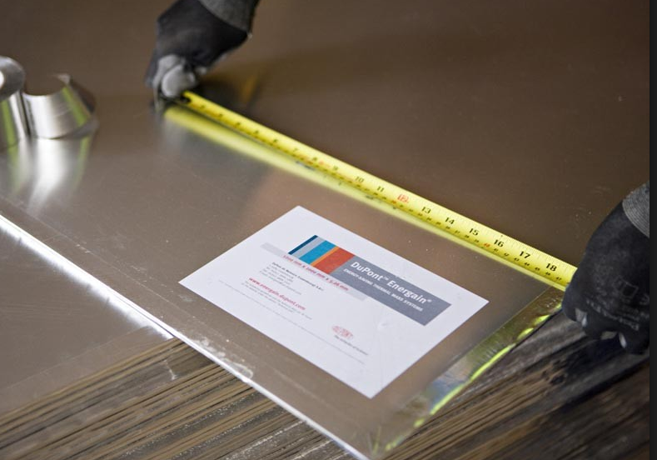
Three different types of responsive methods:
Smart materials
Unlike intelligent systems, which need some computational effort to operate, smart materials have some kind of embedded intelligence so that it is capable of being controlled in such a way that its response and properties change under a certain stimulus
(IOPscience, 2014)

